Slide 1

DirectNet Application Modernization Kick-Off Meeting - 11/8/2017

Slide 2

Agenda
Project Overview
Project Contact Details
Applications In Scope
Application Contacts Required
Indicative High level schedule
Testing Approach
Next 2 months Schedule
Communication Plan
Application owners support required

Slide 3
Project Overview
Migrate all the identified legacy DirectNet Applications to Azure PaaS through one of the following approaches
Migrate .Net Framework 4.x applications to Azure PaaS
Migrate legacy applications (that have source code available) to .NET Framework 4.5.2
Reverse engineer the applications with no source code and upgrade them to latest .NET framework 4.5.2
Document the As-Is functionality of the application
Develop automated Test suites of the application
Setup Monitoring and alerts
Applications will be ready for Production implementation latest by Oct 2018
Discovery & Assessment will be completed by Jan 5th 2018
UAT Schedule will be communicated in Jan 2018
First set of applications will be ready for User Acceptance testing by February 2018
Sunset the on-premises applications by Nov 2018
Provide Knowledge Transition and Training as required to Application Owners

Slide 4
Project Contact Details
Sponsor : Fikri Larguet, FLarguet@geico.com
Manager : Mario Naranjo, MNaranjo@geico.com
Project Manager : Varaprasad Pasumarthi, Vpasumarthi@geico.com
Project Lead : Ivan Reinafarje, IReinafarje@geico.com
Architect : Phillip Dyson, Pdyson@geico.com
Project Contact Email : DirectNetModernizationTeam@geico.com
SharePoint Site : DirectNetModernization
Project ID to Charge : 8428-2018 Data Center Evacuation Engineering
Project Start Date : Nov 6th 2017

Slide 5
Applications In Scope
33 Applications require contact details
Underwriting, Claims & Financial Systems have the major applications that need to be migrated

Slide 6
Application Contacts Required
AutomatedDispatch
Systems Error Report Form
Test Info Update(SelectionTests)
Demand & Lawsuit Log Home
Sales Call Back Reminder System
Claims Provider Profile Management
SOD Tape Library Mailer Request
GeicoSelectionTests
Help Desk Customer Service Satisfaction Survey
Ideas for Quality
V8 Online Documentation
CSMCollector
CSR Call Driver
Forcedownload
Score Card Summary Report
Iowa/Coralville/Associate Lookup
Approval Authority/Sales SOB Table reqeusts
Section Move / Status Change
Region IV Departments
AC98 Refund Request
Region IV/CashVoucher
R4 Manual Quote
Region 4 Service PMT Application
Region 4 Supervisor Goal Grading
Region 4 SAS
Region6/Claims/CSR/Monitor
Region I Home Page
GeoWebService
Services/RentalWAS
Services/Reporting/InterviewTracking
CA Stat Reporting
Controller Home Page
StaffDepartments/QualityAdministration/IQ

Slide 7
Indicative High Level Schedule
Discovery & Assess
Applications will be documented
Non-functional requirements will be elicited
Overview of the Applications by owners
Walk through sessions with owners
Acceptance of Requirements/Test Strategy
Prioritize the list of applications by Release
Design and Execute & Migrate
Each Release will spread across 3 to 4 Sprints with 3 weeks each
Continuous UAT will start after the first Sprint
Review and acceptance of Test cases
Perform UAT Testing & provide acceptance
Design, Development and QA testing will be performed
Walk through sessions with Application owners – code, application, deployment
Hyper-care
Hyper-care is extended at the end of every release cycle, for the applications rolled out in production
Transition and parallel support with Application owners
* Application level release dates will be prioritized as part of the Discover Phase in review with owners
Blue Highlighted Tasks represent the Application owners Involvement during the Project, Communication will be sent with date

Slide 8
Indicative Applications Priority by Area/Release
Release 4
Unidentified Applications
Release 3
Sales
Human Resources
Knowledge Management
Client
ITSM
Business Messaging
NOC
Release 2
Billing
Claims
Underwriting
Policy
Desktop Systems & Distribution
Enterprise Security
Release1
Financial Systems
Knowledge Management
Billing
* Its an Indicative Priority, Applications Priority will be finalized during the Discovery & Assessment

Slide 9
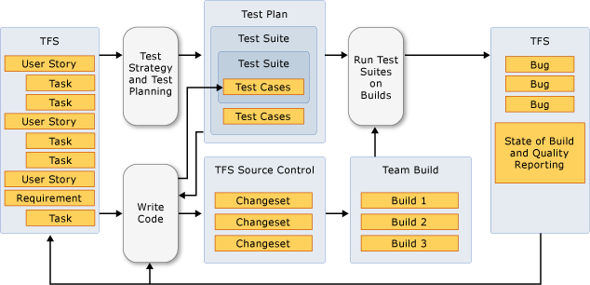
Testing Approach
Sprint Testing
End to End traceability in VSTS
Release N
Sprint 1
Sprint 2
Sprint 3
W1
W2
W3
W1
W2
W3
W1
W2
W3
VSTS
VSTS
v
Early Defect detection
v
Ability to Support daily
builds
ü
Completed
ü
Completed acceptance
v
Adherence to planned
acceptance criteria
criteria
schedules and budgets
ü
Completed non
ü
Completed non
acceptance criteria
acceptance criteria
ü
Optimize test cases
ü
String S1 + S2
ü
Automat test cases
ü
Optimize test cases
ü
Automat test cases
AUTOMATED SMOKE TESTING (on
-
demand)
EXPLORATORY TESTING
FUNCTIONAL TESTING
INTEGRATION & REGRESSION TESTING
CONTINUOUS EXECUTION

Slide 10







Next 2 Months Schedule
Meet with Application Owners
Understand business functionality & identify key components
Access current environment & code repositories
Reverse Engineer the Assemblies
Documentation of Applications
Identify risks, dependencies and constraints
Prioritize &
Release Planning
Kick Off Meeting
Discovery Phase Schedule

Slide 11
Discovery – Application Area Schedule
Financial Systems
December
Knowledge Management
November
Business Messaging
Underwriting
Sales
Desktop Systems & Distribution
Enterprise Security
Human Resources
ITSM
NOC
Unidentified areas
Billing
Claims
Policy
Client
Human Resources

Slide 12
Communication Plan
Contact Email for Questions: DirectNetModernizationTeam@Geico.com
SharePoint will be updated on regular basis on the updates of the Project and Application Release Schedule
Planned Meetings & Frequency
Sprint Retrospective & Review meeting for each Sprint (3 weeks)
Monthly Scrum of Scrums with Sponsor & Key stakeholders
Quarterly Stakeholder Meetings with Application Owners

Slide 13
Support we need from Application owners
Help required in providing business overview of the applications
Help with identifying any dependencies for the application migration
Review & accept the documented functional specifications
Review and accept the Test cases in VSTS
Perform User Acceptance Testing and provide the acceptance to deploy the migrated application
Quick turn-around for timely reviews/clarifications to the DirectNet Migration team
ETAs will be shared during the discussion with the application owners

Slide 14
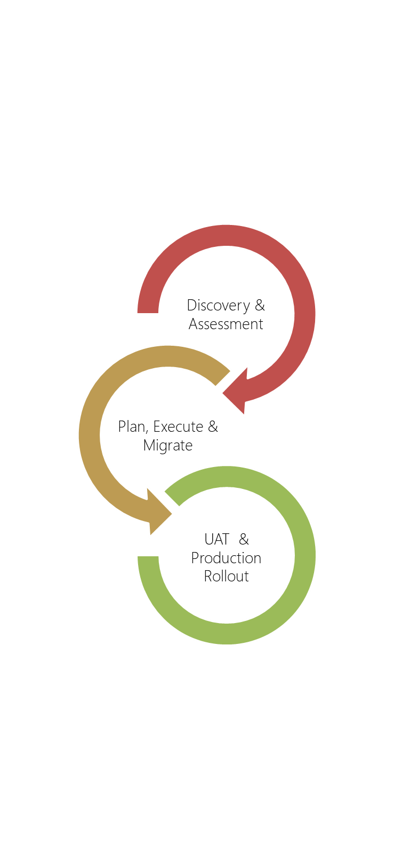

Application Owners Involvement & Knowledge Transition
Understand the usage of application and SLA
Understand any pending changes or plans for changes
Understand any non-functional requirements
Present the understanding of application
Prioritize applications rollout, discuss the roadmap and timelines
Outcome
Requirement Specification Document
Test cases in VSTS, traceability to user stories in VSTS, automated test suite
Migrated code base in Azure & VSTS
Monitoring & Alerting information ( Splunk, OMS & AppInsight)
Azure Subscription information
Runbooks for L1/NOC teams
Design walk through
Discuss Subscription cost, Topology, setting up Alert distribution list
Changes needs to be made and communicated to User
Database porting strategy
Plan the Go-Live Date & Sunset Dates
Transition
Test and provide acceptance of the application
Communication with new URLs and instructions
Verify the application in production
Sun set the on-premises instances

Slide 15

THANK YOU

